Slide 1
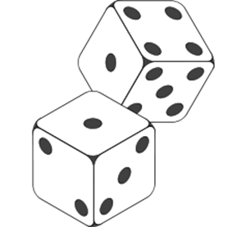
Roll a short story!
Where will your story be set?
1. At the beach
2. In a magical forest
3. In an abandoned park
4. At a busy shopping centre
5. In the playground
6. In a restaurant
What will your plot be?
1. Something goes missing
2. An unexpected visitor
3. Someone gets lost
4. A mysterious object is found
5. An unsuspecting door leads to a magical land
6. Someone wins something life changing
How to plan a story.
https://www.bbc.co.uk/bitesize/articles/zhh992p#:~:text=The%20plot%20is%20what%20will%20happen%20in%20your%20story.&text=Build%20up%20%2D%20What%20is%20going,character%20deal%20with%20the%20problem%3F

