Slide 1
Welcome to Bankhead Primary Parent Information Session

Slide 2
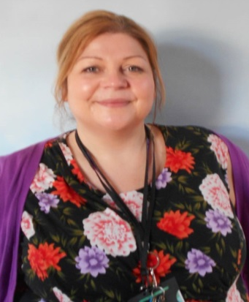
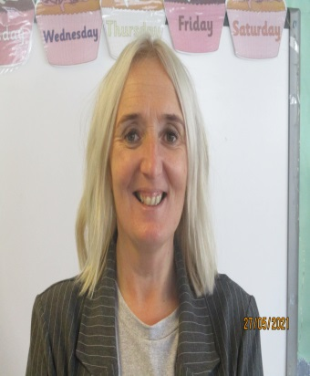
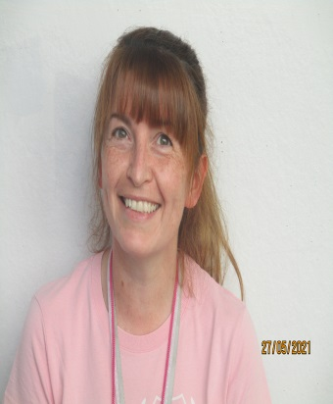
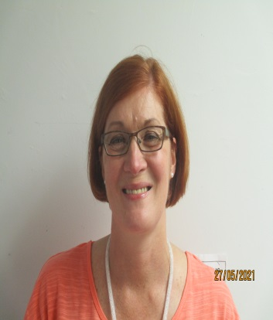
Management Team
Mrs McKinlay
Head Teacher
Mrs Hamilton
Depute Head Teacher
Mrs Earl
Acting Depute Head
Mrs Napier
Acting Depute Head
Miss Douglas
Acting Principal Teacher

Slide 3
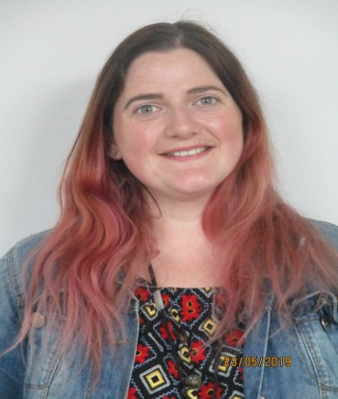
Your P1Teachers
Miss J. Boyd
P1a Teacher
Miss C McKinstray
P1b Teacher

Slide 4
Your First Day
All pupils will be met by a member of our management team at GATE 1 BROADLIE AVE
ONE PARENT/GUARDIAN ONLY will be allowed within the school grounds.
Your child will be met by their class teacher
Parent/Guardian should leave via Gate 2

Slide 5
After Day One
All pupils will have a start time of 9.15am for the remainder of Week 1 i.e. Tuesday 17th to Friday 20th
ONE PARENT/GUARDIAN ONLY will be allowed within the school grounds
Week 2 - pupils will leave parent/guardian at the school gate
‘We’re Off To Bankhead’ explains the standard school day.

Slide 6
The School Day
Week 2-24.8.2021
Start Time – P1a 8.45am / P1b 9.00am
Home Time - P1a 2.45pm /P1b 3.00pm
One parent/guardian is permitted in playground to collect pupil.

Slide 7
Uniform
Uniforms in our school colours can be purchased from any shops, or you can order uniforms with the embroidered school badge from the school office.
Our uniform consists of:
(P1-P6) Pale blue polo shirt or white shirt & striped Bankhead Primary School tie
(P7) White shirt & navy blue Bankhead P7 tie
Royal blue or grey jumper/sweater or cardigan
Grey skirt, pinafore or trouser
Please label all items of clothing and other belongings with your child's name.

Slide 8
Transition Afternoon
You will meet your class teacher at the transition afternoon
You will receive a Welcome Pack with important school information and fun activities

Slide 9
Website and Social Media
We encourage all parents to access our website for key information. We also share pupil learning via twitter.
www.bankhead-pri.glasgow.sch.uk
@BankheadGCC

Slide 10
Frequently Asked Questions?
Do you have a breakfast club?
Our school has a Breakfast Club provided by Fuel Zone from 8.00am - 8.45am
Do you have information on school clothing grants?
Families on low incomes may be eligible to receive a School Clothing Grant award of £110 for each qualifying child.

Slide 11
Who do I contact if my child is sick?
Please contact the Absence Reporting Line
0141 287 0039
or
0141 471 3710

Slide 12
What should my child wear for gym?
On gym days pupils are encouraged to wear their gym outfit to school. Due to restrictions pupils should wear t-shirt, jumper, leggings/tracksuit trousers and trainers
Can I park at the school?
Between the hours of 8.30am-9.15am and 2.30pm-3.15pm, Caldwell Avenue and Broadlie Drive will be strictly pedestrianised.
We ask that you please respect the car free zones during pick up and drop off for the safety of the children.

Slide 13
Do you have an after school club?
Bankhead After School Care Service (BASCS) is available from 3pm to 6pm during term time.
For more information contact:
Jacqueline Ross
Phone: 07305 469 195
Email: bankhead.bascs@gmail.com

Slide 14
THANK YOU!!
We look forward to seeing you soon

