Slide 1
Welcome to Bankhead

Slide 2
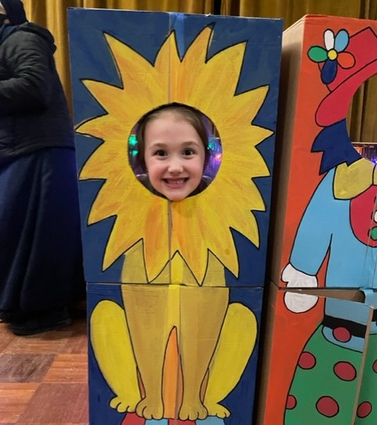
Many of you joined us at our
February Fling

Slide 3
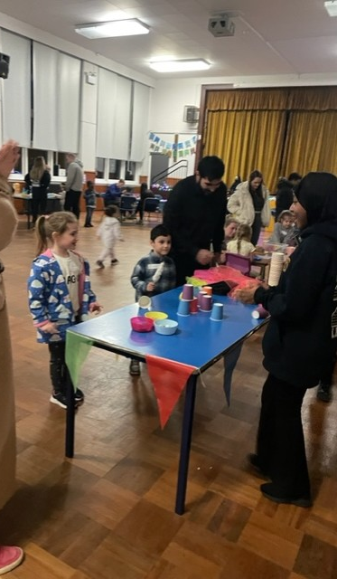
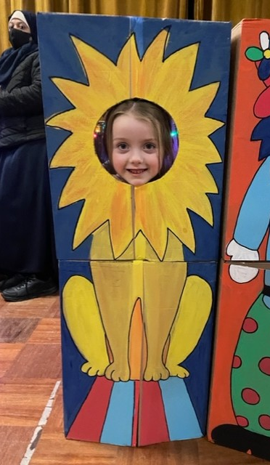
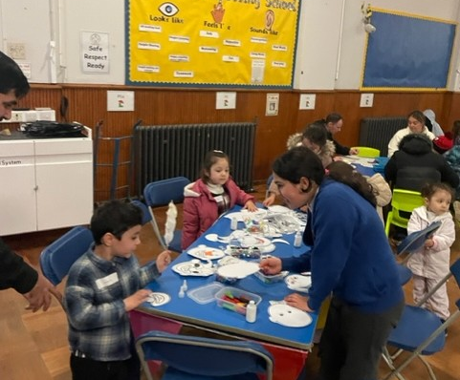
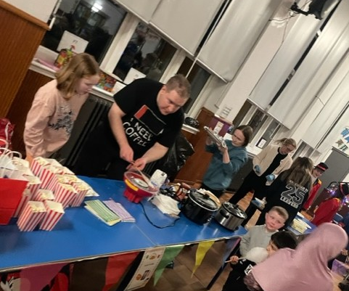

Slide 4
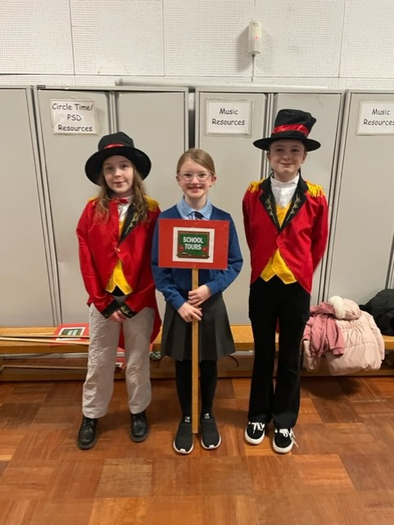
Heading off on a tour of the school

Slide 5
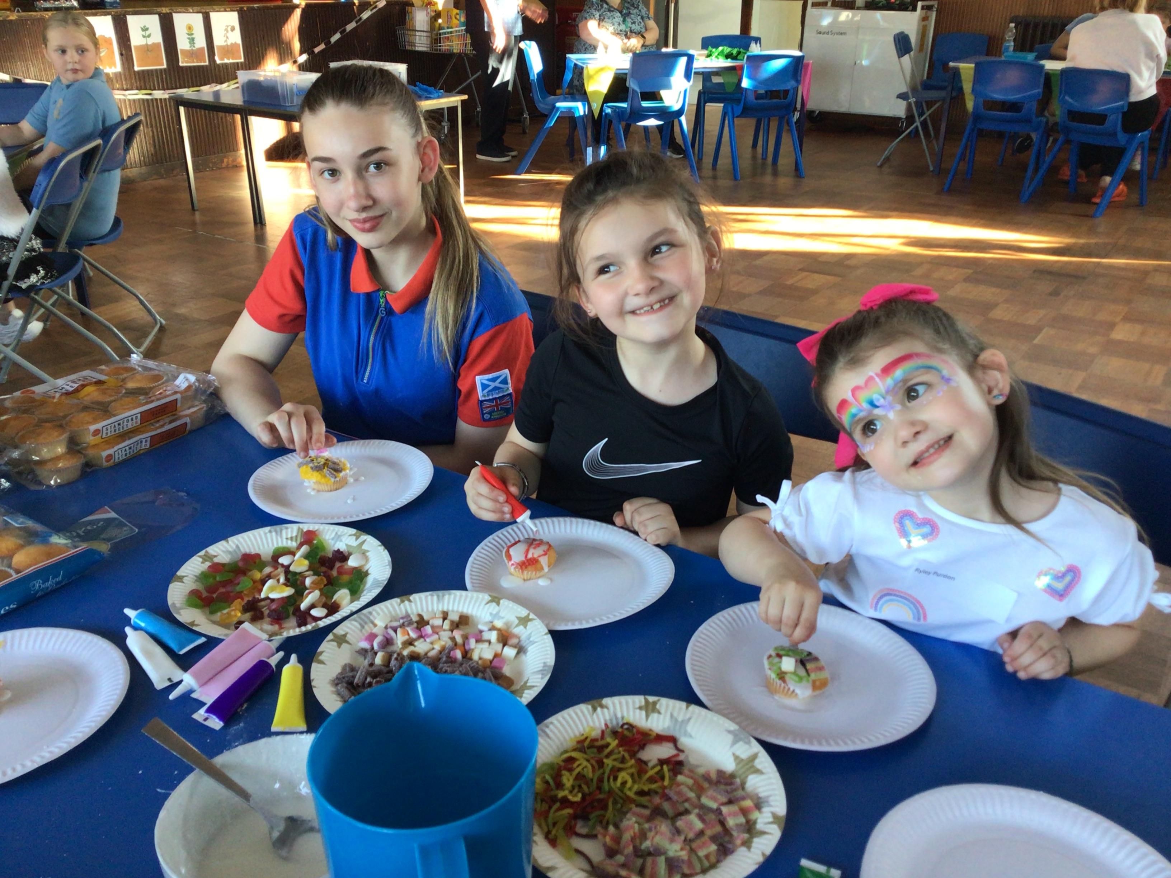
Awesome April

Slide 6
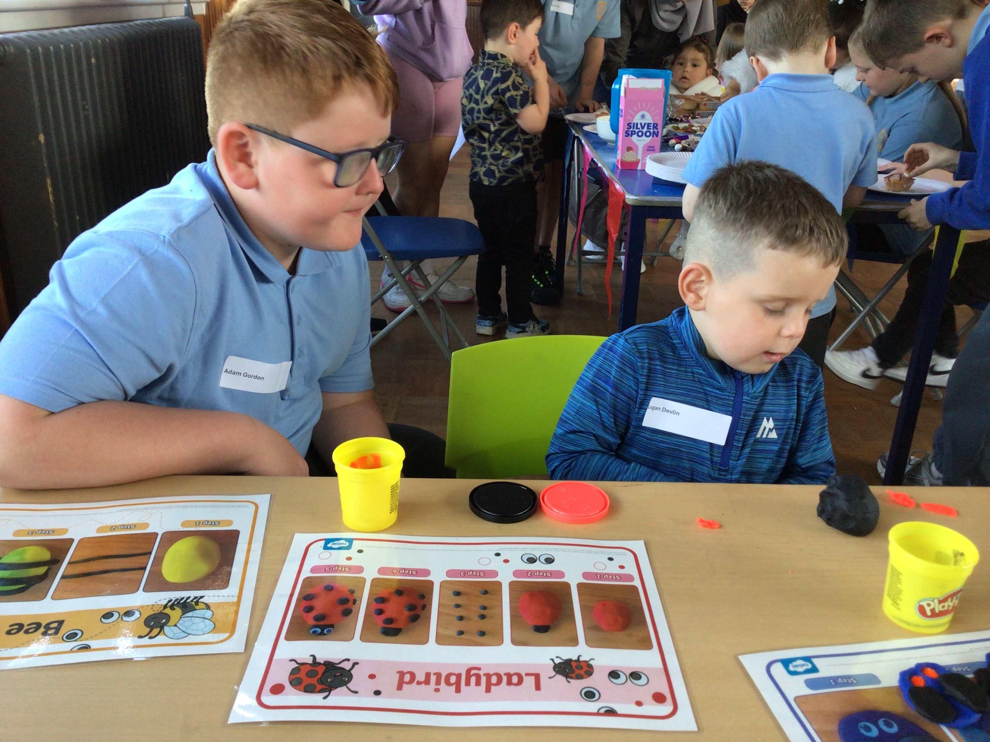
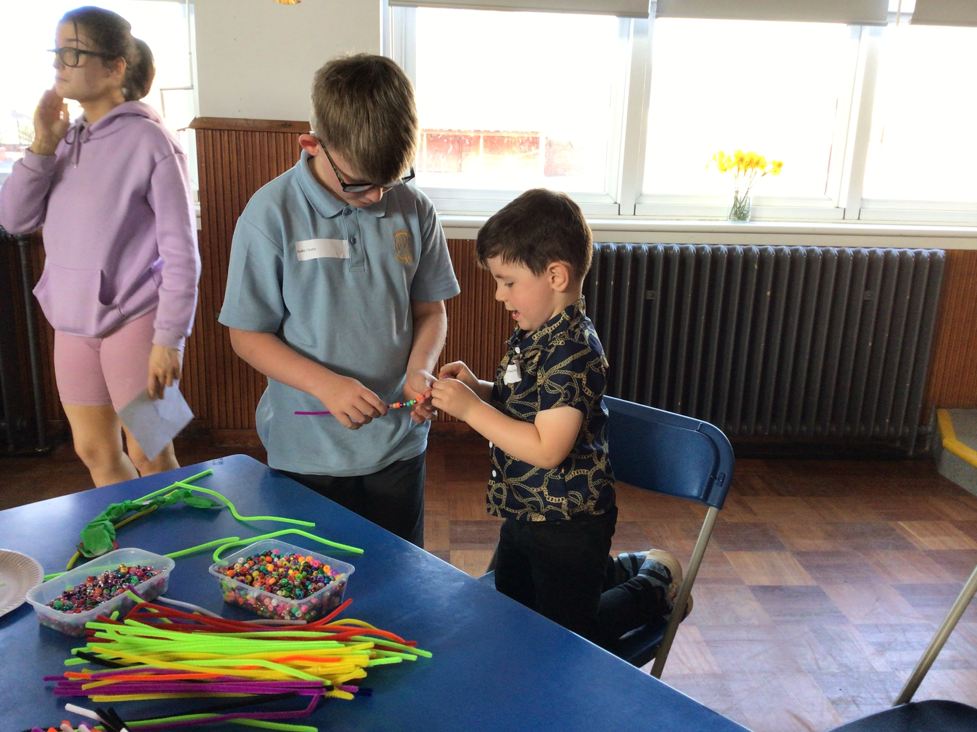

Slide 7
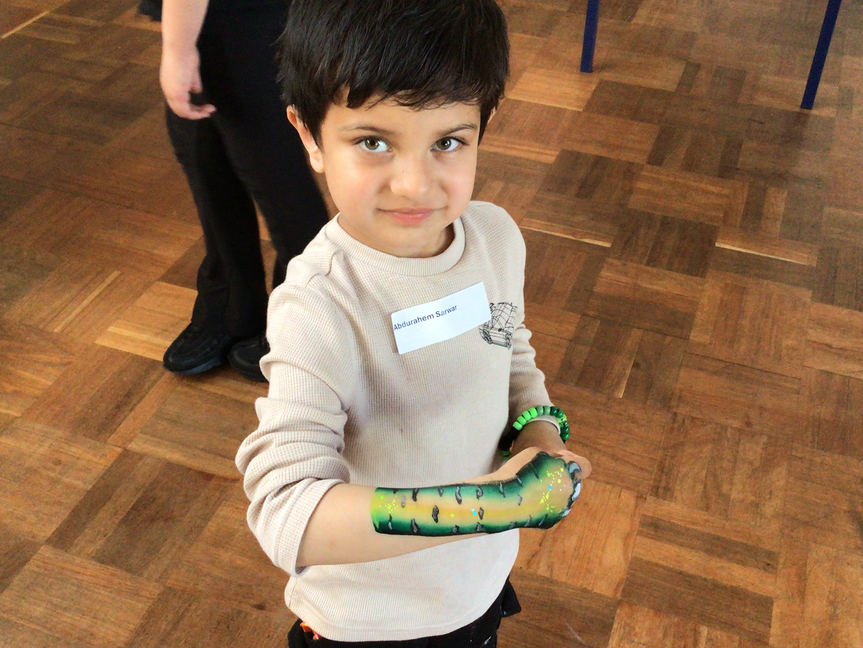
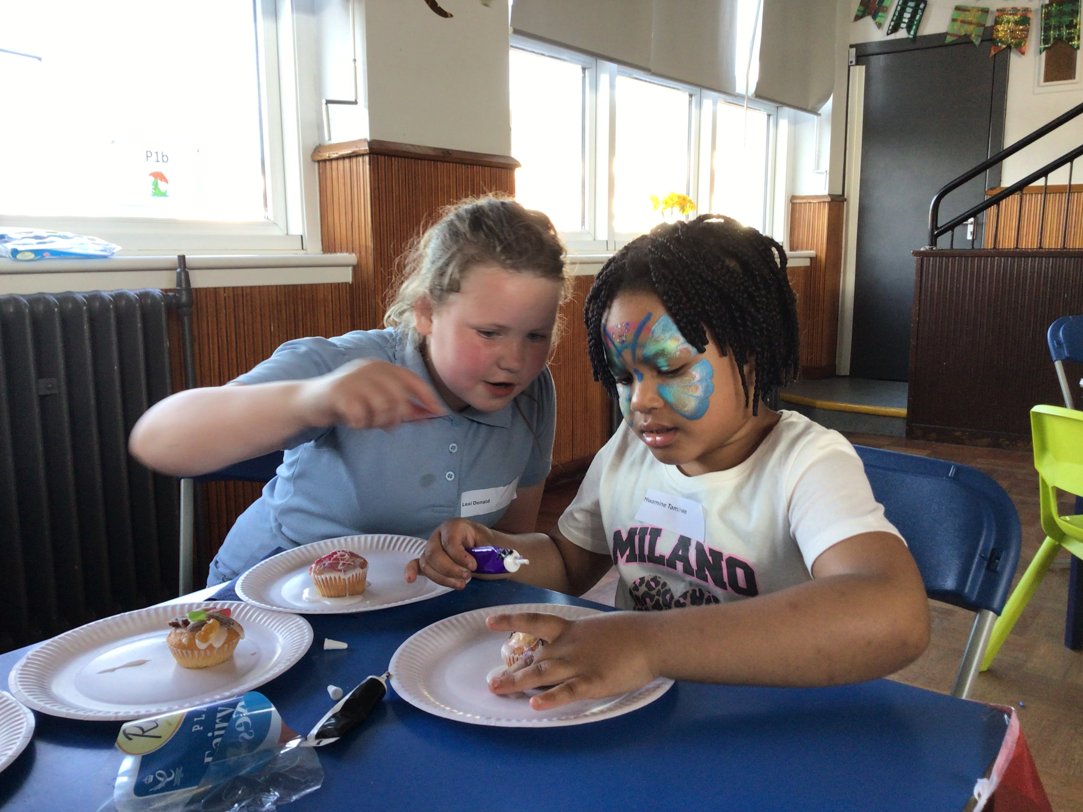
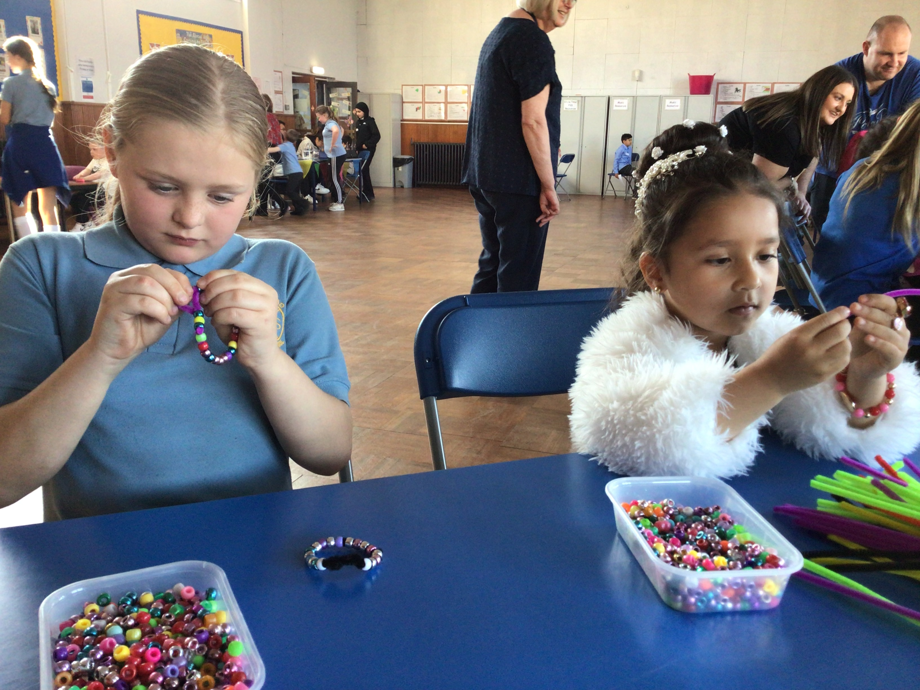
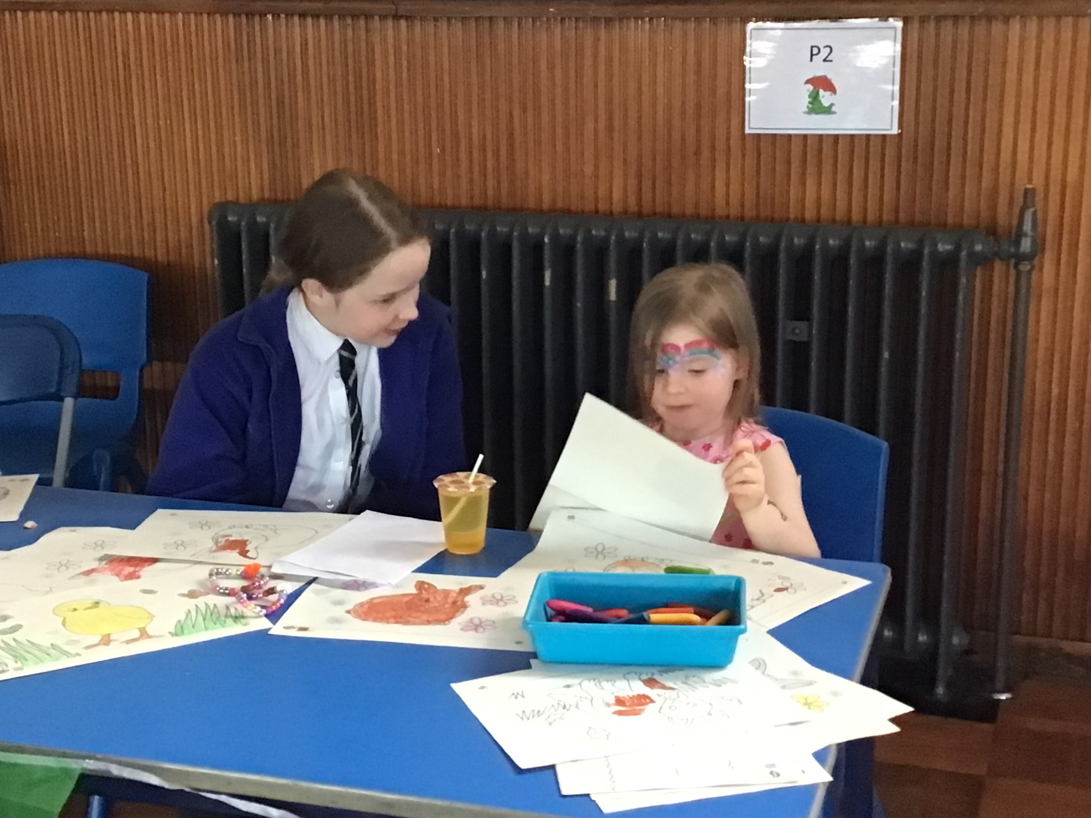

Slide 8
Our School Day
9:00am
Our day begins
10:30am Infant Playtime
12:30pm Lunch Time
3:00pm Home Time
A school day is a very busy day, there are lots of things that happen! Here is some information on how the day is organised!

Slide 9
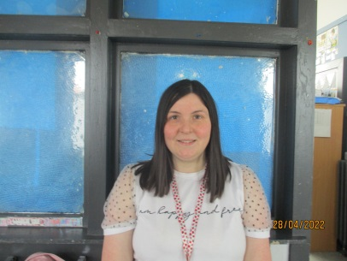
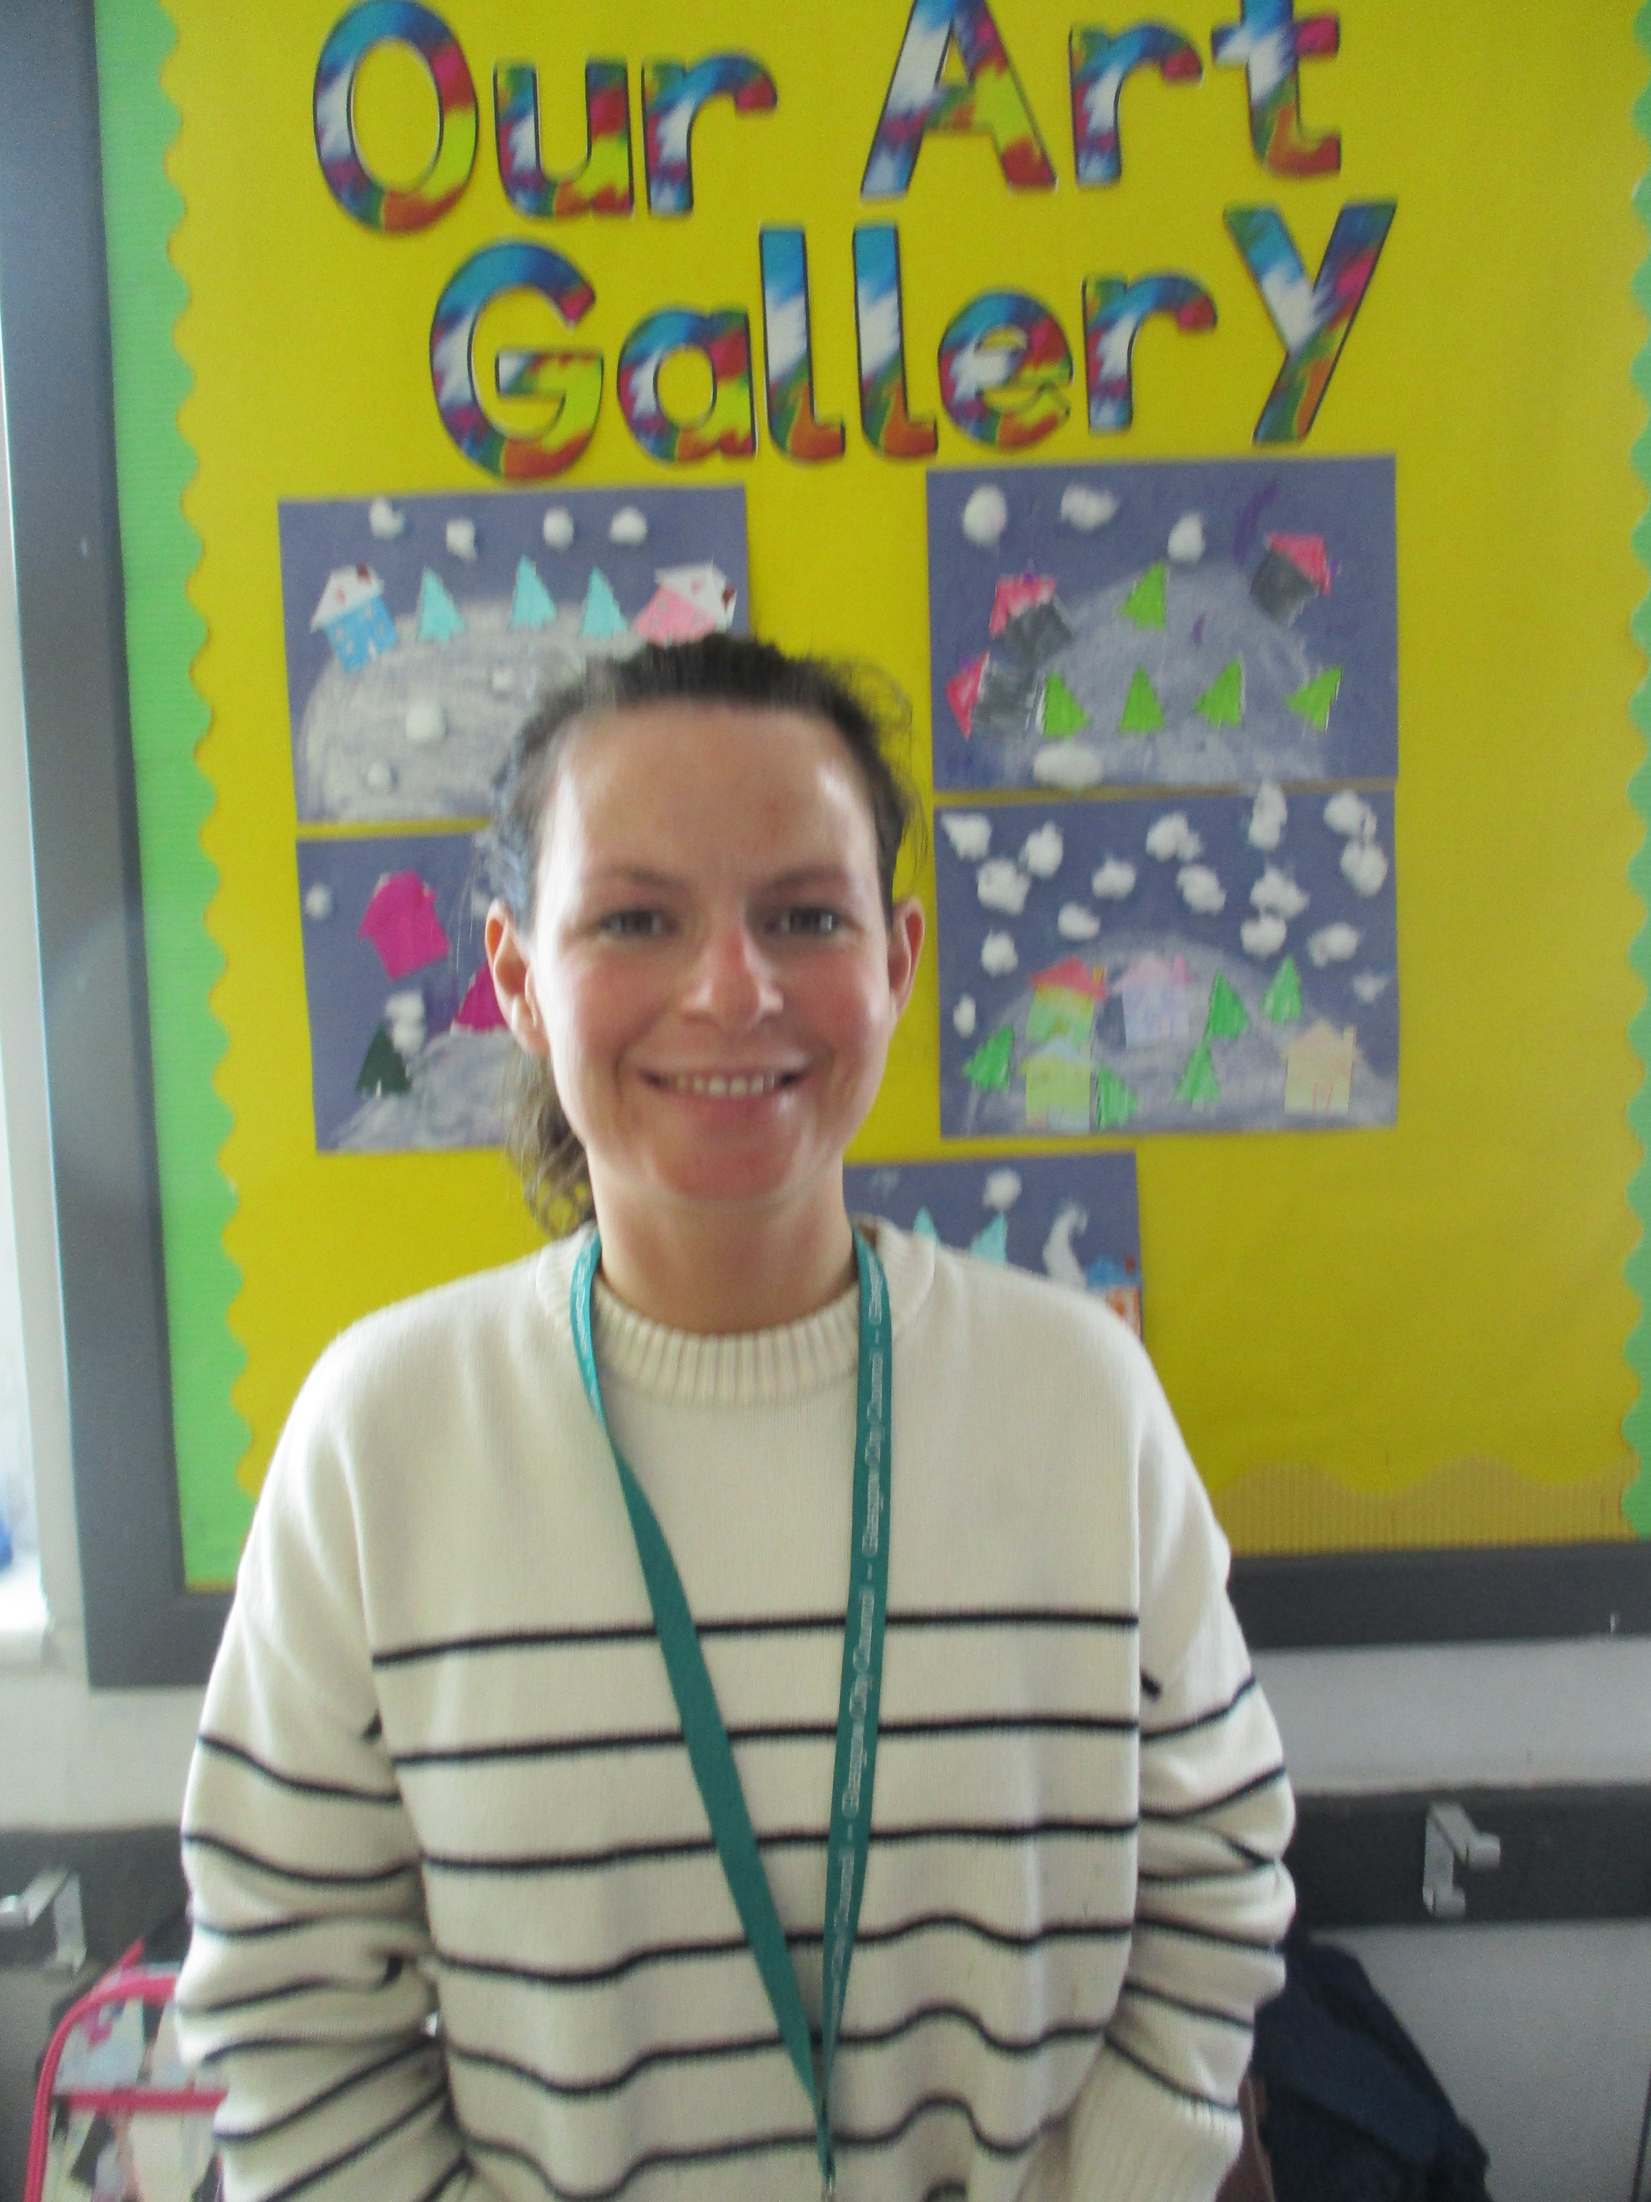
Infant Teachers
Mrs Moore
Miss Diverty

Slide 10
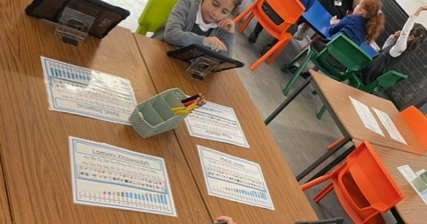
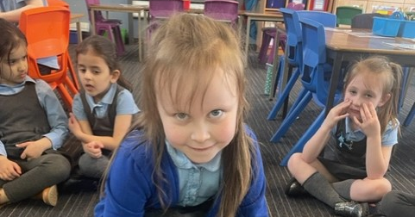
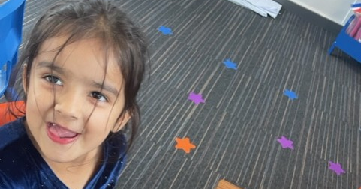
9:00 – Our day begins
Parent/carer can bring pupils into the playground via gate 1 Broadlie Drive.
Pupils will play with their friends/buddy until the bell rings. Your buddy will help you to your line and then your teacher will take you to your class.
Breakfast Club, starts at 8:00am and costs £2.00 for the oldest pupil then £1.00 for additional siblings. Entrance is via the dinner hall at the main entrance of the school.

Slide 11
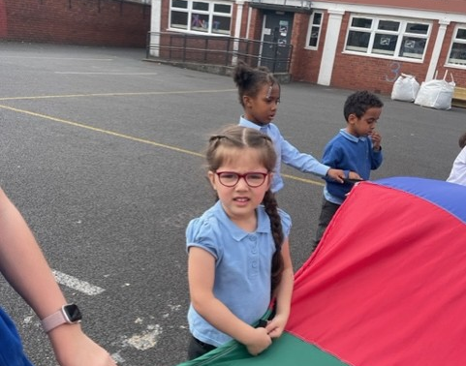
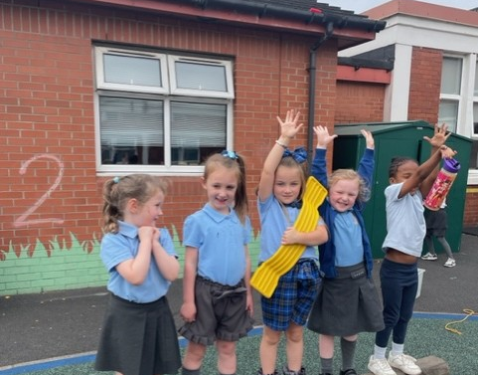
10:30 - Play Time
(15 minutes)
At 10:30am will go out into the playground to play. They should bring a small healthy snack to eat at play time! During play time, they will run around, play with their friends or sit at the tables and chat!
The playground can be a bit scary to begin with, so for the first few days pupils will play with their P7 buddies, this helps them get used to playing in the playground!
CHALLENGE
Encourage your child to-
Practise putting on their shoes.
Practise buttoning/zipping their jacket
Practise opening up packets/peeling fruit, etc.
Make sure they can use the toilet and know about washing their hands.
Practise taking turns at games and sharing with others.
There will be adults to help in the playground, but it is important that pupils can do things on your own now they are a big P1!

Slide 12
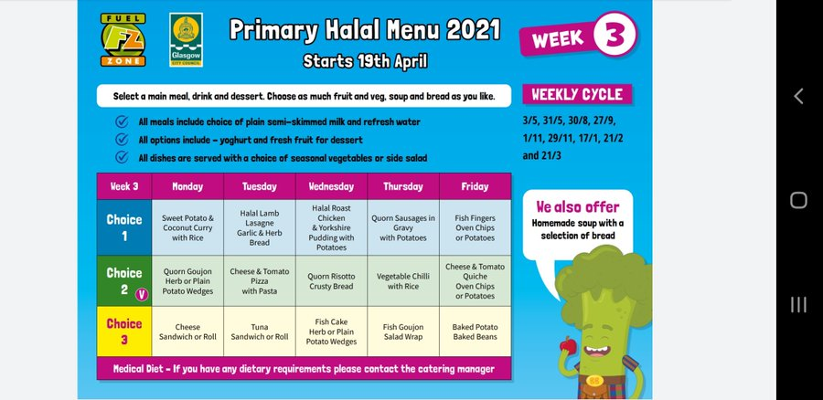
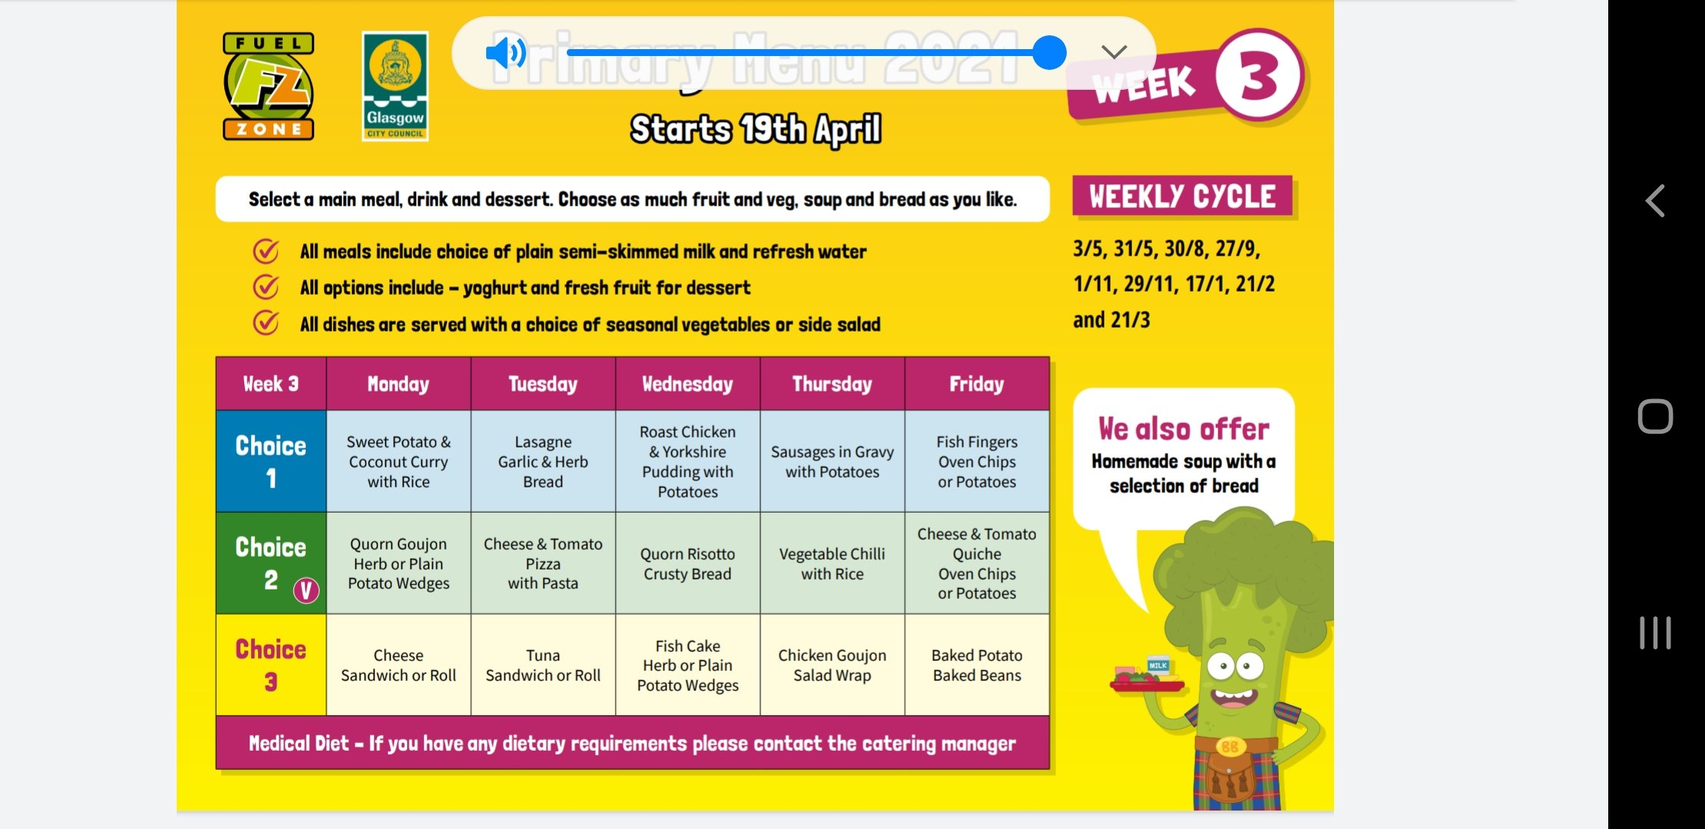
12:30 - Lunch Time
Some people like to eat a school lunch and some like to bring a packed lunch, it’s really up to you!
School lunches must be ordered via the Parent Pay app.
www.parentpay.com
You can order four weeks ahead
Please discuss with your child the choices and place orders before 8am.
We eat lunch in the lunch hall. For the first few weeks, their P7 buddy will help in the lunch hall.
When they have finished their lunch pupils can go out to play!
CHALLENGE
Encourage your child to-
Practice using a knife and fork.
Practice clearing away their plate from the table after they have eaten.
Practice carrying their plate.

Slide 13

Home Time
We invite parents/carers to collect pupils from the playground, this helps everyone to get to know each other!
Please arrive via gate 1 Broadlie Drive.

Slide 14
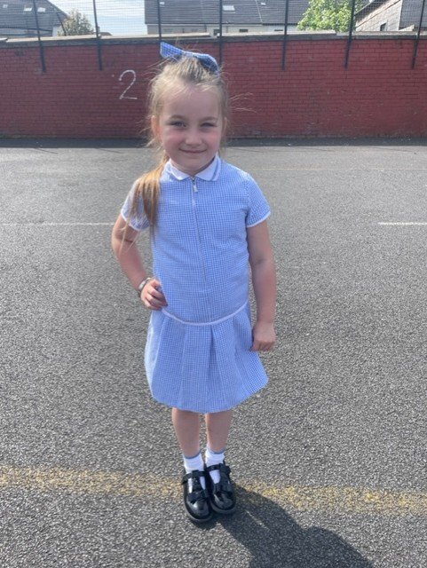
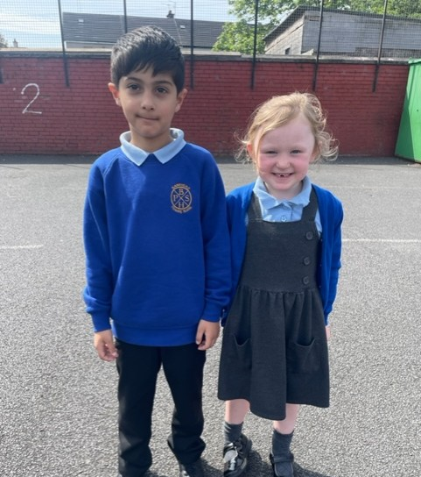
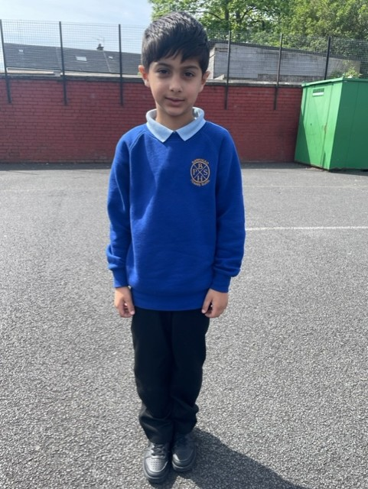
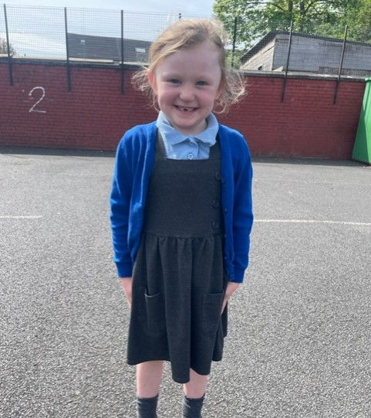
Uniform
When children come to school, they wear a uniform. We are very proud of our school uniform and think it is very smart!
Our uniform consists of:
(P1-P6) Pale blue polo shirt or white shirt & striped Bankhead Primary School tie
(P7) White shirt & navy blue Bankhead P7 tie
Royal blue or grey jumper/sweater or cardigan
Grey skirt, pinafore or trouser
Ties are available to buy today £7.00
Please label all items of clothing and other belongings with your child's name.
Uniform Suppliers
www.schoolwearmadeeasy.com/badged-school-uniform/a-d/b/bankheadprimary-school-knightswood
https://myclothing.com/Bankhead-primary/-school/27662.school

Slide 15
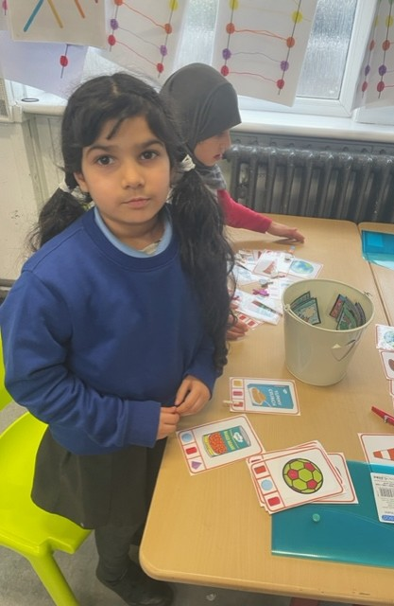
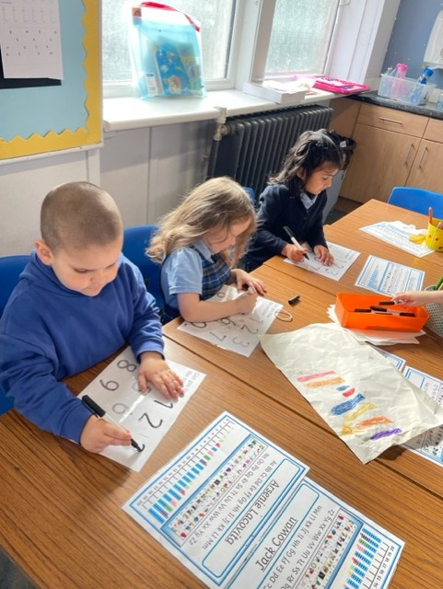
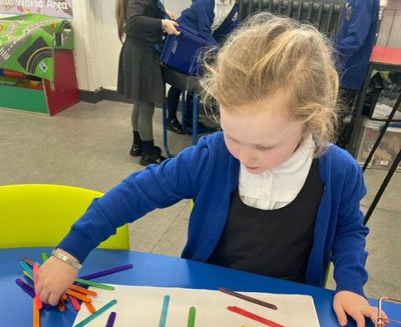
Learning at School
Pupils will learn lots of new and exciting things! In the next few slides we will show you the different curricular areas.

Slide 16
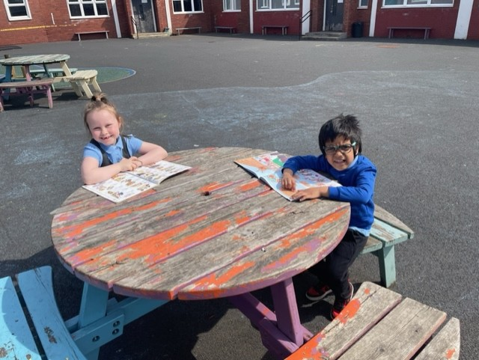
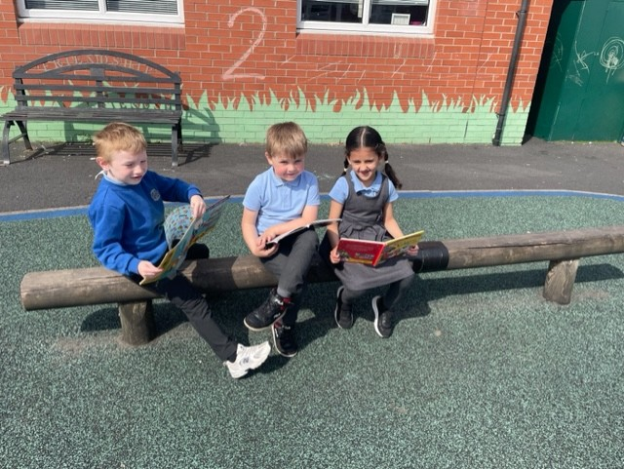
Literacy - Reading
In Bankhead, we LOVE reading!
Pupils will learn how to read lots of new words and before you know it, they will be reading lots of their favourite books!
CHALLENGE
Sing some nursery rhymes or make up your own silly stories!
Read a book each day.
Talk about their favourite story.

Slide 17
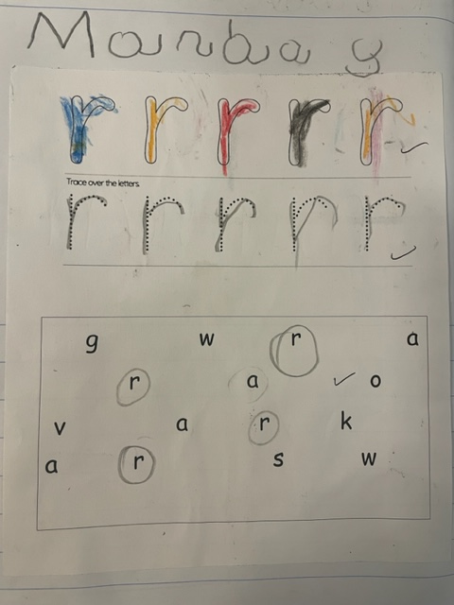
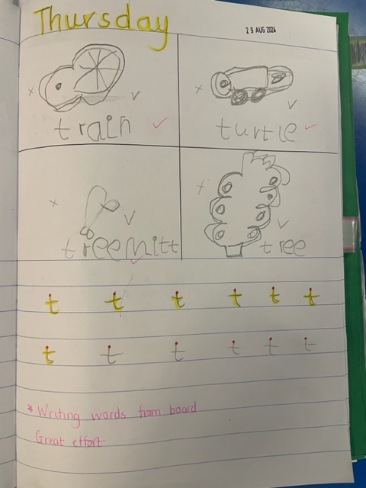
Literacy – Phonics and Spelling
Pupils will learn lots of new sounds that will help them with reading and spelling. They will learn how to spell common/tricky words!
We learn in lots of different ways!

Slide 18
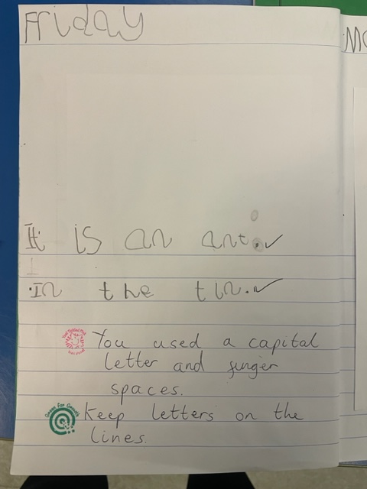
Literacy - Writing
In Primary One we write about lots of interesting things. Your child will soon be writing their own fabulous stories!
CHALLENGE
Spend time drawing and colouring. Can your child hold their pencil using the correct grip?

Slide 19

Languages
You will learn new languages! In school, we learn some French!
Each year, we celebrate European Day of Languages.

Slide 20
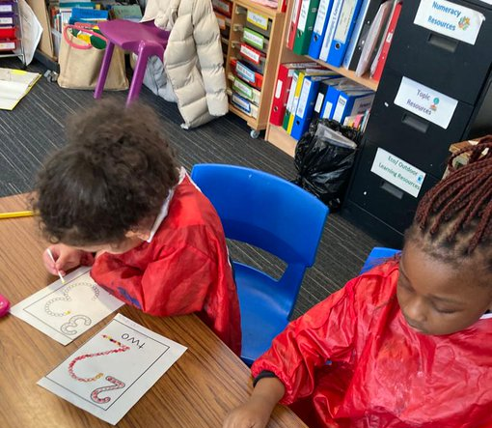
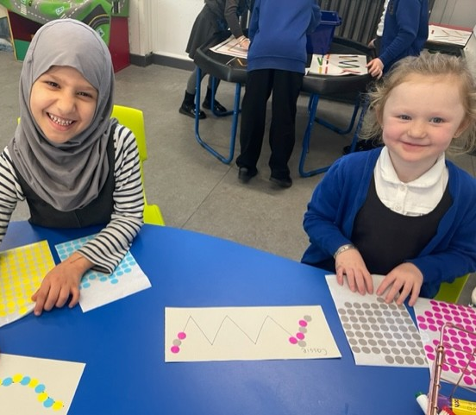
Numeracy and Mathematics
Pupils will learn lots in their first year of Primary school! In no time, they will be adding and subtracting like a pro. They will be using money, exploring shape, using data. By the end of Primary One they will be a “mathemagician!”
Challenge
Encourage your child to-
Count to 10 to 10
Sort and match – you can do this with socks!
Weigh and measure by baking!
Count objects around your home.
Look for numbers when you are out and about

Slide 21
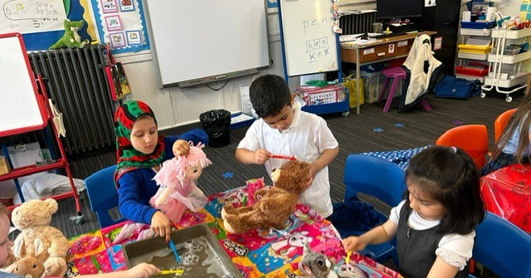
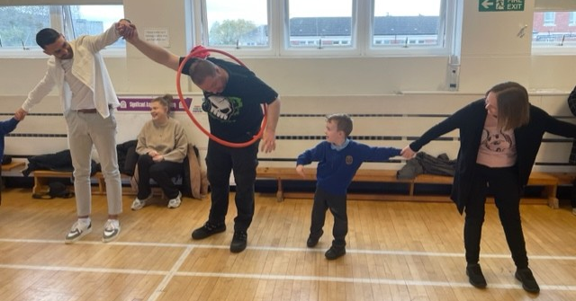
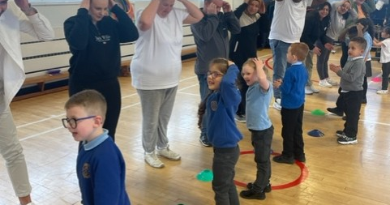
Health and Wellbeing
In school we like to learn about how to keep ourselves healthy and safe. We really enjoy P.E. activities!
Challenge
Talk with your child about the ways you can keep yourself healthy and safe!
Try skipping
Play lots of active games

Slide 22
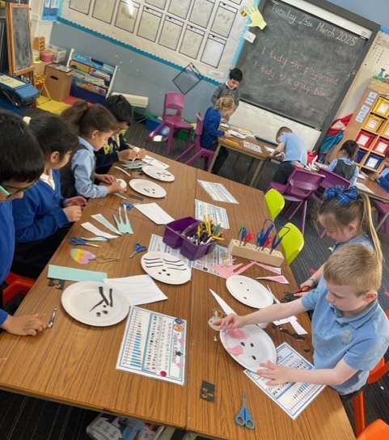
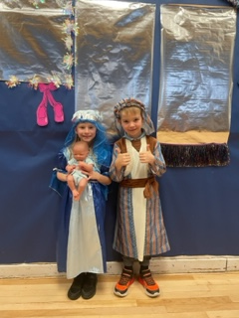
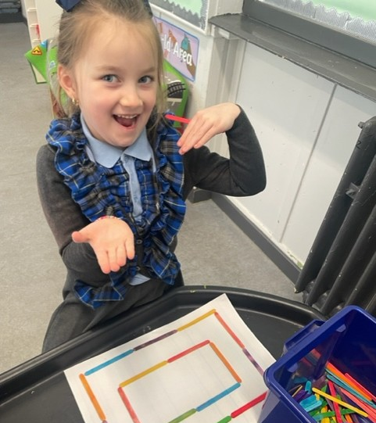
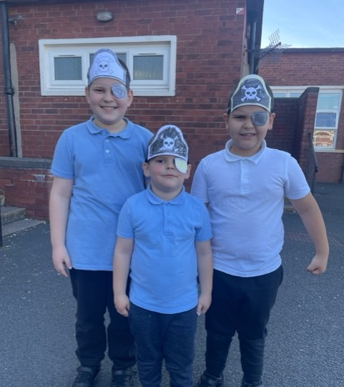
Expressive Arts
In Primary One pupils will take part in lots of art and design, music and drama activities!
Challenge
Sing lots of songs and rhymes!
Colour in a picture.

Slide 23
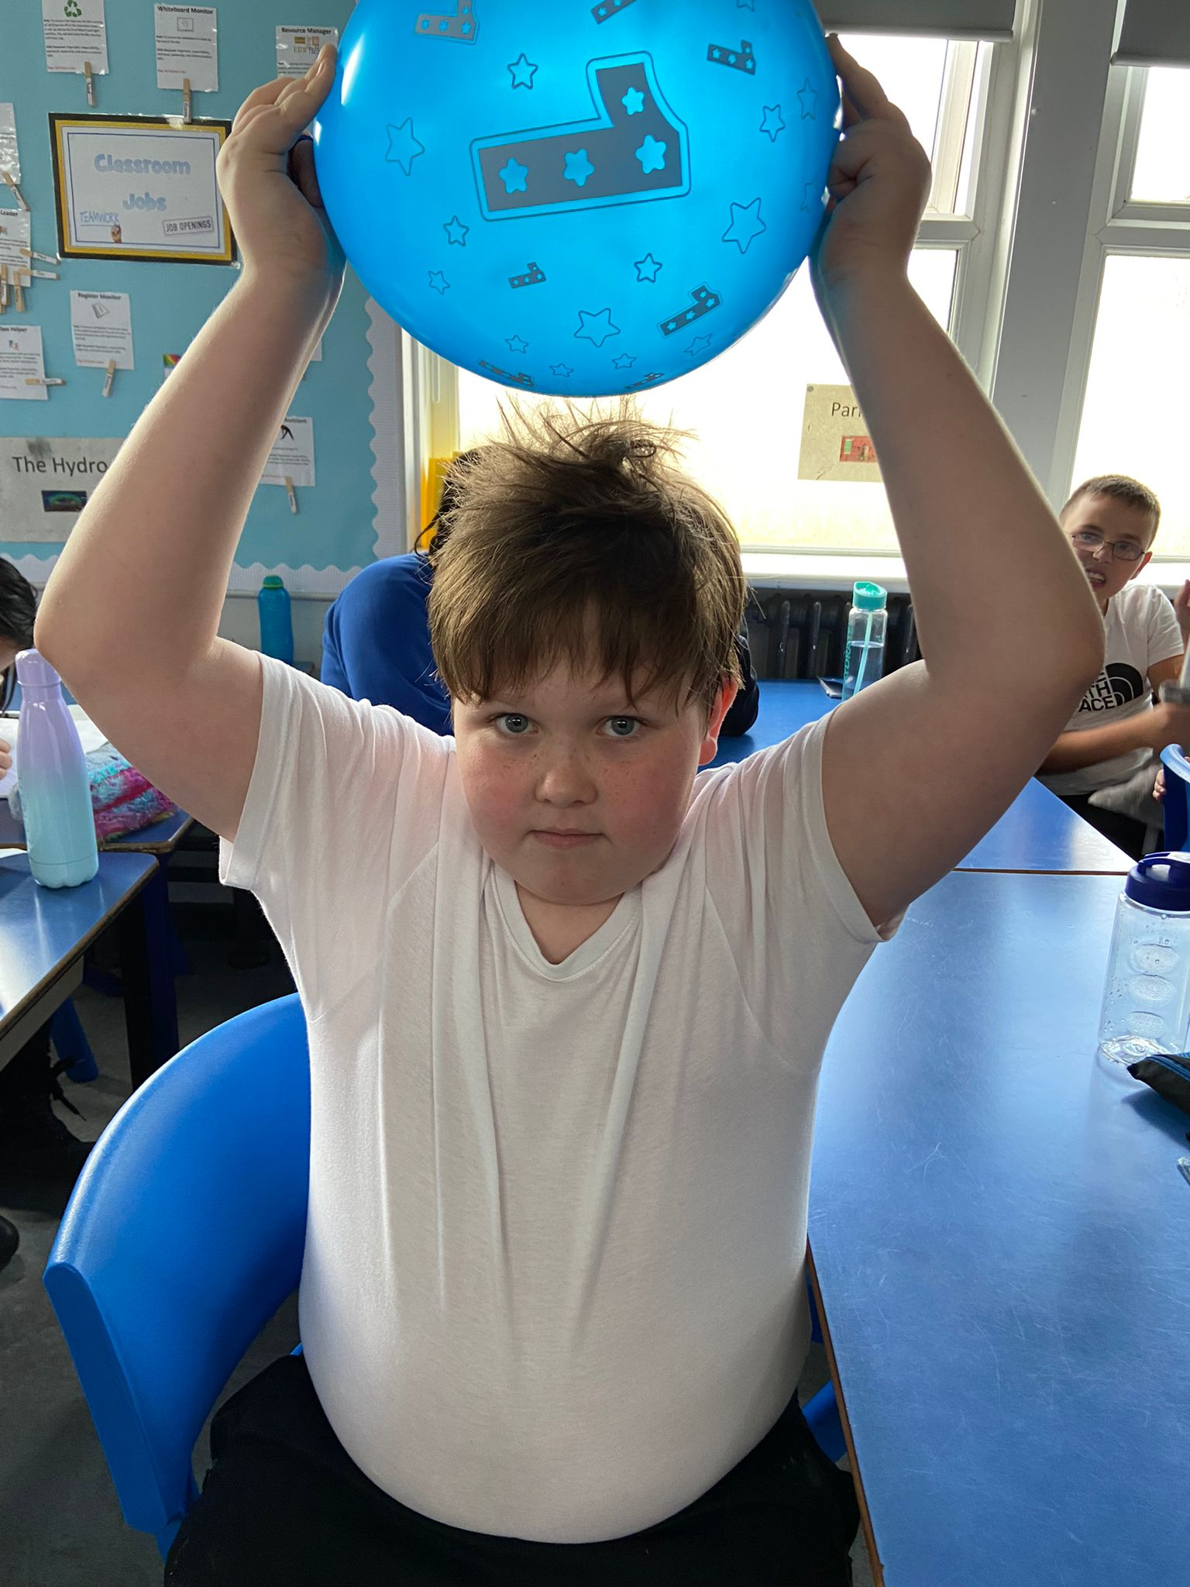
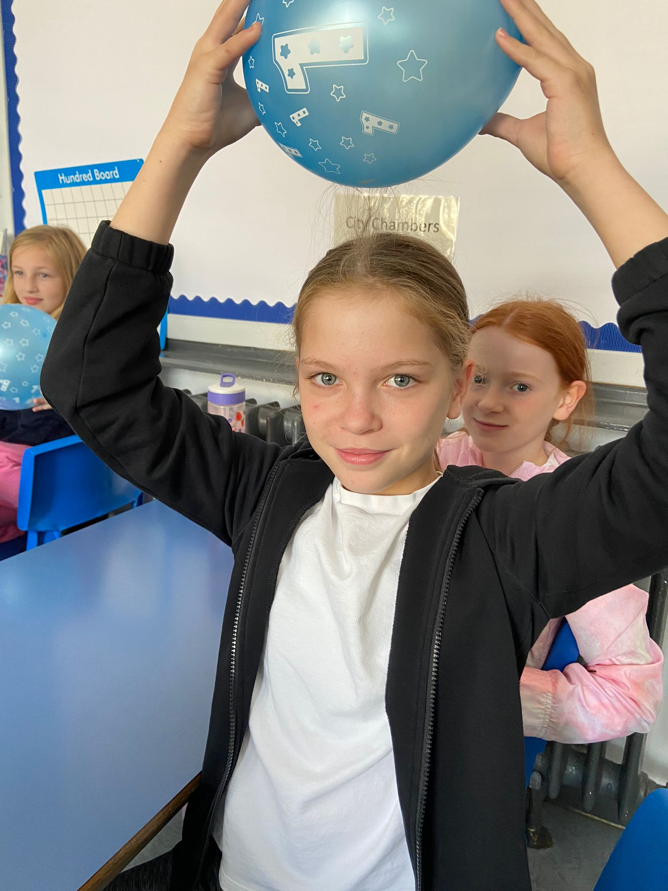
Sciences
Science helps us to understand the world around us! Here are some of our pupils investigating static electricity!
Challenge
Try a simple science experiment. Here are some ideas.
http://www.sciencefun.org/kidszone/experiments/

Slide 24
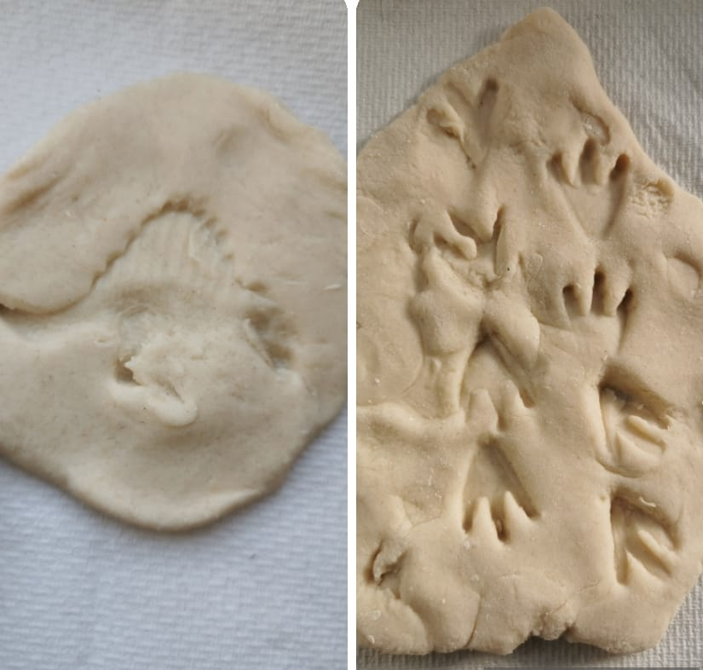
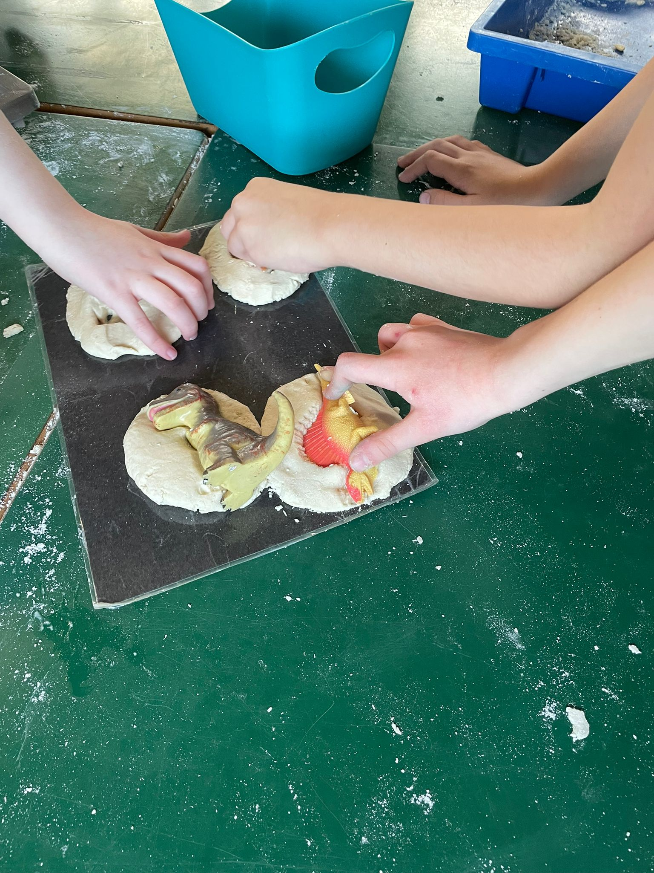
Social Studies
We develop an understanding of people, places, events, society, economy and geography through Social Studies.
Challenge
One of the first topics in Primary One is “People Who Help Us.” Think about someone who helps your child. Can they draw a picture of that person?

Slide 25
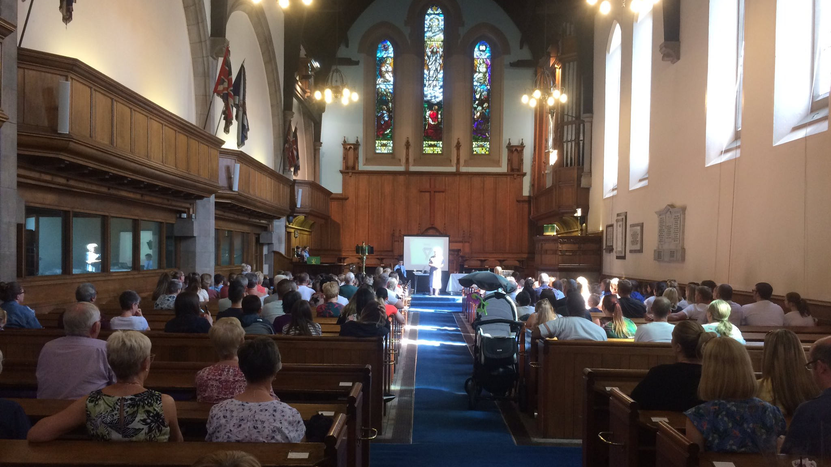
Religious and Moral Education
We learn about Christianity, Islam, Sikhism, Judaism and other World Religions.
We go to Church throughout the year. This allows us to come together as a school community.

Slide 26
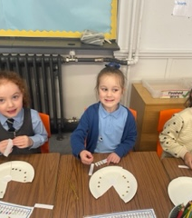
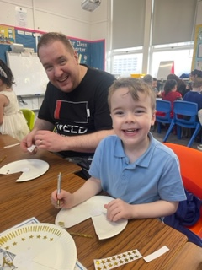


Technologies
Pupils will create and design lots of things in Primary One. Most Primary One pupils love using the iPads and the Smartboard in class is also great fun!

Slide 27




Events
Launch Foods

Slide 28



Coffee and Catch-Up
September

Slide 29



Christmas Crafts

Slide 30






Allergies
PLEASE DO NOT PROVIDE
NUTS,
NUT PRODUCTS e.g Kinder Bueno, Hazelnut spread
KIWIS
AS PART OF SNACK OR LUNCH AS WE HAVE PUPILS WITH ALLERGIES TO THESE PRODUCTS.

Slide 31
Induction Visit Two
15th May
Parents and pupils should arrive at Gate 1 on Broadlie Drive at the back of the school.
Pupils should arrive for 1.30. Parents should then return at 2.15 to collect their child and we will have a short presentation of homework bags.

Slide 32

Homework Bags
Your Childs First Day at School
We’re off to Bankhead
What will your child be learning?
Cutting Skills Workbook
Pencil Skills Workbook
Book
Pencil case

Slide 33
Frequently Asked Questions?
Do you have information on school clothing grants?
Families on low incomes may be eligible to receive a School Clothing Grant award of £110 for each qualifying child.
Who do I contact if my child is sick?
Please contact the Absence Reporting Line
0141 287 0039 or 0141 471 3710
OR
Call school and press Option 1
Do you have an after school club?
Bankhead After School Care Service (BASCS) is available from 3pm to 6pm during term time.
For more information contact:
Jacqueline Ross
Phone: 07305 469 195
Email: bankhead.bascs@gmail.com

Slide 34
Keep in Touch
E-Mail: Headteacher@bankhead-pri.glasgow.sch.uk>
Phone: 0141 959 3531
Web: www.bankhead-pri.glasgow.sch.uk
Twitter: @BankheadGC
School app for parents-
scan qr code on leaflet within your pack today

