Slide 1

Positive Emotions

Slide 2
Task:
Create a colourful, eye-catching pattern filled with as many positive emotion words as you can.

Slide 3
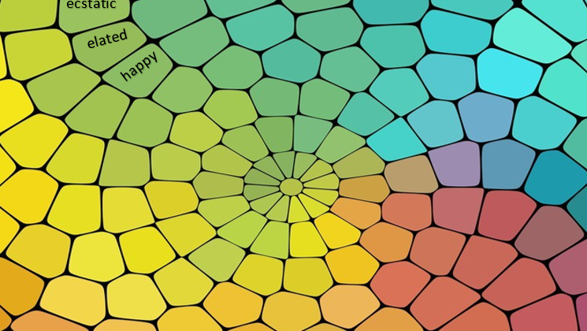

Slide 4

proud
joyful
happy
calm

Slide 5

calm
elated

Slide 6
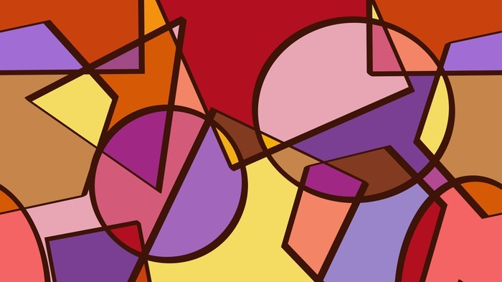
buoyant
happy
ecstatic

Slide 7
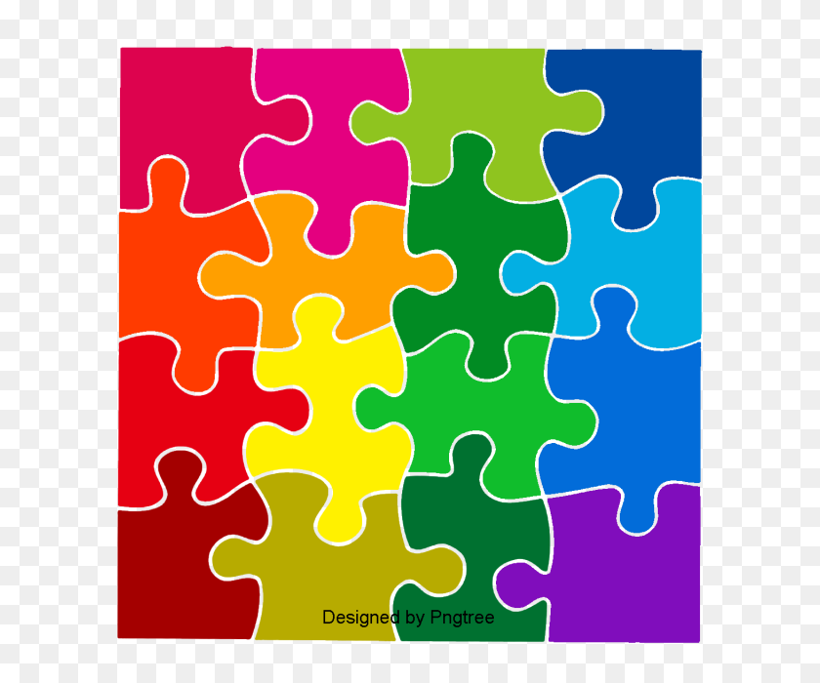

Slide 8


Slide 9
LI: To describe emotions. SC: I can list a range of positive emotion words.

