Slide 1
Spelling
March 2019

Slide 2
Spelling – Previously
Not given enough priority in a busy week
Spelling list introduced at beginning of a week
Homework driven
Words not particularly reinforced during the week
Weekly spelling test

Slide 3
Spelling – Now
North Lanarkshire programme introduced in session ’16–‘17
Now in our 3rd year
North Lanarkshire programme now recommended city wide
We continue to up skill new staff through coaching and drop in sessions
Features structure and progression

Slide 4
Spelling – Improvements
Spelling is specifically taught every day
Multi sensory and active
Peer work/assessment
Self assessment
Apply spelling knowledge across the curriculum

Slide 5
Spelling Stage 1
Initial sounds/phonemes - two a week
Action game - passing a box of objects
Teacher models how to write letter
Pupils form letter in the air, on their hand, on the floor

Slide 6
Spelling Stage 1
Teaching Order
To allow for early word building, these phonemes are taught first:
s a t p i n
Phonemes are the smallest units of sound in a word e.g. pin p/i/n or chip ch/i/p

Slide 7
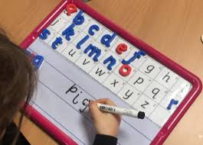
Spelling Stage 1
Jolly Phonics stories and songs reinforce the sounds
Magnetic letters used in pairs to make words
Carousel of active spelling activities
throughout week
Focus groups to reinforce the sounds, teach formation and write words containing phoneme

Slide 8
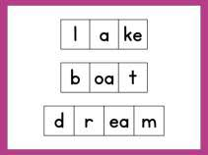
Spelling Stage 1
The use of elkonin boxes is modelled and pupils write words in these, remembering that one box is for one sound.

Slide 9
Spelling Stage 1
Common words are taught each week
the
into
old
and
you
out
my
with
now
got
much
your

Slide 10
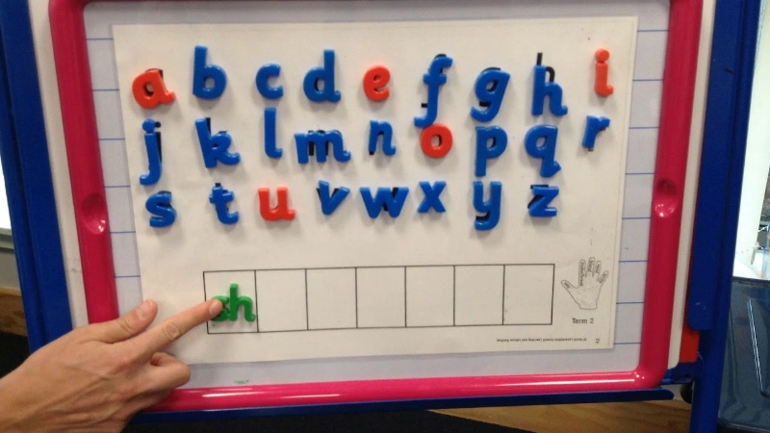
Spelling Stage 1
Progress to digraphs: one a week (two letters that together make one sound e.g. sh, ch, th)
Term 4 Word Reader and Word Maker introduced – links to spelling stages 2 & 3

Slide 11
Spelling Stage 2 & 3
Day 1
Letters used to make the new phoneme of the week
Listen to phoneme story and identify words with selected phoneme
Form phoneme letters in the air, on their hand, on the floor then write on their board
Model how to spell words using magnetic letters

Slide 12
Spelling Stage 2 & 3
Day 1
Pupils spell words with own magnetic letters
Pupils read and cover up their words before writing them independently
Pupils use the familiar strategy:
Say Make/Break Blend Read
Cover Write Check

Slide 13
Spelling Stage 2 & 3
Day 2
Word Reader and Word Maker – pairs
Using magnetic letters and independent writing

Slide 14
Spelling Stage 2 & 3
Day 3
Models sentences using two or three of the phoneme words
Pupils write one or two sentences
Targets include capital letters, full stops, joining words, neat handwriting
Share sentences with another pair

Slide 15
Spelling Stage 2 & 3
Day 4
Models how to sound out and write words on elkonin boxes
Word Reader and Word Maker using elkonin boxes
Teacher/partner dictation

Slide 16
Spelling Stage 2
Some Common/Tricky Words
after
are
said
their
come
could
only
of
her
by
new
before

Slide 17
Spelling Stage 3
Some Common/Tricky Words
which
three
too
what
these
school
bring
again
some
long
people
never

Slide 18
Spelling Stage 4 & 5
Similar structure as stages 1-3
Partner working continues
Four week programme introduced

Slide 19
Spelling Stage 4 & 5
Two weeks focus on teaching the different representations of a phoneme sound
e.g. ‘ee’ can be made by:
ee, e, ea, ie, e-e.
Ten day programme includes independent and partner tasks to consolidate phonological awareness

Slide 20
Spelling Stage 4 & 5
Week 1 Monday
L.I. Know that a sound can be spelt in different ways
S.C. List different ways of spelling the sound ee

Slide 21
Spelling Stage 4 & 5
Week 1 Tuesday
L.I. Know different ways to spell the sound ee
S.C. Make lists of words in spelling patterns for each phoneme

Slide 22
Spelling Stage 4 & 5
Week 1 Tuesday
ee | e | ea | ie | e-e
see free sleep | be he behind | sea team peace | thief field mischief | these here complete

Slide 23
Spelling Stage 4 & 5
Week 1 Wednesday & Thursday
L.I. Investigate how to break words into phonemes
S.C. Break words into the smallest units of sound (elkonin boxes)
Check accuracy

Slide 24
Spelling Stage 4 & 5
Week 1 Friday
L.I. Spell words containing target phonemes with accuracy
S.C. Write the words, circle the phoneme and partner check

Slide 25
Spelling Stage 4 & 5
Week 2 Monday
L.I. Investigate how letters and sounds come together to form words
S.C. Use diacritical marking code
Record the number of sounds in a word

Slide 26
Diacritical Marking Code
Single sounds/phonemes are marked with dot under the sound
_ Joined phonemes are marked by
underlining with a dark line
Split phonemes are marked with a joining loop

Slide 27
Diacritical Marking Code
shape

Slide 28
Spelling Stage 4 & 5
Week 2 Tuesday & Wednesday
L.I. Investigate how letters and sounds come together to form words
S.C. Use diacritical marking code
Record the number of sounds in a word (working in pairs)

Slide 29
Spelling Stage 4 & 5
Week 2 Thursday
L.I. Correctly spell words with the ee phoneme from the phoneme story
S.C. Listen to story
Use knowledge of phoneme to spell accurately
Check with a partner

Slide 30
Spelling Stage 4 & 5
Week 2 Friday
L.I. Use knowledge of phonemes to spell accurately
S.C. Choose a strategy
Spell accurately

Slide 31
Spelling Stage 4 & 5
Week 3 Monday & Tuesday
L.I. Use a variety of spelling strategies to spell common/tricky words
S.C. Explain strategies used to spell the words

Slide 32
Spelling Stage 4 & 5
Some Common/Tricky Words
listen
beautiful
important
million
frightened
decided
accident
different
counting
emotion
satisfied
bought

Slide 33


Spelling Stage 4 & 5
+ =

Slide 34
Spelling Stage 4 & 5

Slide 35
Spelling Stage 4 & 5
Some other spelling strategies include:
Phonic Knowledge (ch/ai/n)
Syllabification (hol – i – day)
Words within Words (country – count/try)
Mnemonic (because)
Spelling Rules (no words in English end in ”v”, they use “ve” – gave, have, above)

Slide 36
Spelling Stage 4 & 5
Week 3 Wed, Thurs & Fri
L.I. Spell common/tricky words accurately
S.C. Use spelling strategies to spell common words accurately

Slide 37
Spelling Stage 4 & 5
Week 4 Monday
L.I. Know common spelling rules
S.C. List words for the spelling rule

Slide 38
Rule One:‘q’
L.I. The letter ‘q’ is always followed by the letter ‘u.’
Together they make the ‘kw’ sound.
quiz, acquaintance, quiet, quite, aqua, earthquake, quaint, equation, consequence, equilateral, quadrilateral, acquire

Slide 39
Spelling Stage 4 & 5
Week 4 Tuesday
L.I. Use the spelling rule
S.C. Spell accurately
Partner check spelling and help if required

Slide 40
Spelling Stage 4 & 5
Week 4 Wednesday & Thursday
L.I. Practise targeted spelling strategies
S.C. Use active spelling strategies to consolidate spelling.

Slide 41
Spelling Stage 4 & 5
Week 4 Friday
L.I. Peer and self assessment of spelling
S.C. Identify successes and next steps in spelling

Slide 42
Spelling Stage 4 & 5
Spelling Activities
Rainbow writing
Backwards, capital, dot writing
Hangman
Magazine cuts
Highlighting
Spelling tennis
Lots more!

Slide 43
Spelling Stage 6 & 7
Part 1
Continue to build on previous learning
Spelling strategies and spelling rules continue to be the focus
Children work with partners to problem solve how they can spell
Common words appropriate to stage, interdisciplinary learning, writing genre features or current school events

Slide 44
Spelling Stage 6 & 7
Part 2
Investigating root words and affixes
Understanding how these affect the meaning of a word
Root word: consider (to think about)
Prefix: re (again) reconsider (think about again)
Suffix: ate (state of) considerate (showing thought)
Homophones e.g. ate and eight.
Confusions e.g. conscience and conscious.

Slide 45
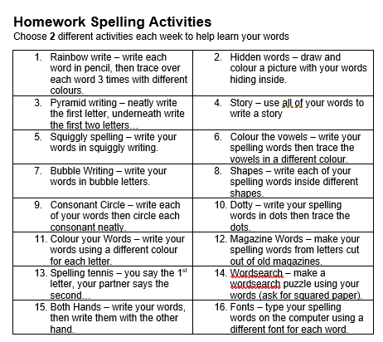
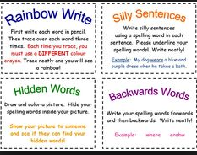
At Home

Slide 46
At Home
Stages 1 - 3
Find, read and write words containing known phoneme within reading books, newspapers, magazines etc
Take turns to dictate simple sentences, which contain the phoneme words and take turns to be the ‘teacher’ and check each other’s work

Slide 47
At Home
Stages 4 & 5
Identify words, diacritically mark, dictate sentences or paragraphs containing the phoneme representations
Discuss strategies that could be used to help to spell common words

Slide 48
At Home
Stages 6 & 7
Play games with words - who can make the most words from a root word:
e.g. help, helpful, unhelpful,
helpfully, helpless, helplessly.
Discuss how each word differs in meaning

