Slide 1
Week 1 – Day 1
LI: To spell tricky words.
Shoulder, argument, daughter, foreign, nervous, silhouette, assessment, decide, decision, forty, nuisance, sincerely, atmosphere, definite, fulfil

Slide 2
Week 1 – Day 2
LI: To identify syllables.
Shoulder
Argument
Daughter
Foreign
Nervous
Silhouette
Assessment
Decide
Decision
forty,
Nuisance
Sincerely
Atmosphere
Definite
fulfil

Slide 3
Week 1 – Day 3
LI: To identify phonemes in words.
SC: I can diacritically mark accurately.
Shoulder, argument, daughter, foreign, nervous, silhouette, assessment, decide, decision, forty, nuisance, sincerely, atmosphere, definite, fulfil

Slide 4
Week 1 – Day 4
LI: To use a spelling strategy effectively.
Shoulder, argument, daughter, foreign, nervous, silhouette, assessment, decide, decision, forty, nuisance, sincerely, atmosphere, definite, fulfil

Slide 5
Week 2 – Day 1
LI: To spell homophones/confusing words.
morning mourning muscle
mussel New knew
night knight one won past
passed pause paws piece peace place plaice
Practise practice

Slide 6
Week 2 – Day 2
LI: To identify syllables.
Morning mourning
Muscle mussel
New knew
Night knight
One won
Past passed
Pause paws
Piece peace
Place plaice
Practise practice

Slide 7
Week 2 – Day 3
LI: To identify phonemes in words.
SC: I can diacritically mark accurately.
Morning mourning
Muscle mussel
New knew
Night knight
One won
Past passed
Pause paws
Piece peace
Place plaice
Practise practice

Slide 8
Week 2 – Day 4
LI: To use a spelling strategy effectively.
morning mourning muscle mussel
new knew night knight
one won past passed
pause paws piece peace
place plaice practise practice

Slide 9
Week 3 – Day 1
LI: To spell tricky words.
Analyse, analysis, continuous, February, murmur, separate, announcing, cough, fierce, necessary, sequence, answer, creation, finally, neighbour

Slide 10
Week 3 – Day 2
LI: To identify syllables.
Analyse
Analysis
Continuous
February
Murmur
Separate
Announcing
Cough
Fierce
Necessary
Sequence
Answer
Creation
Finally
neighbour

Slide 11
Week 3 – Day 3
LI: To identify phonemes in words.
SC: I can diacritically mark accurately.
Analyse
Analysis
Continuous
February
Murmur
Separate
Announcing
Cough
Fierce
Necessary
Sequence
Answer
Creation
Finally
neighbour

Slide 12
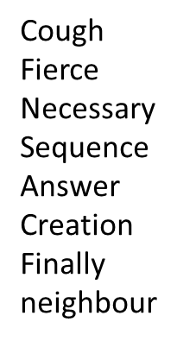
Week 3 – Day 4
LI: To use a spelling strategy effectively.
Analyse
Analysis
Continuous
February
Murmur
Separate
Announcing

Slide 13
Week 4 – Day 1
LI: To spell tricky words.
Once, skilful, audible, design, furthermore, opposite, soldier, audience, desperate, grammar, original, stomach, autumn, develop, guarantee

Slide 14
Week 4 – Day 2
LI: To identify syllables.
Once
Skilful
Audible
Design
Furthermore
Opposite
Soldier
Audience
Desperate
Grammar
Original
Stomach
Autumn
Develop
guarantee

Slide 15
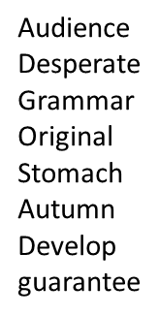
Week 4 – Day 3
LI: To identify phonemes in words.
SC: I can diacritically mark accurately.
Once
Skilful
Audible
Design
Furthermore
Opposite
Soldier

Slide 16
Week 4 – Day 4
LI: To use a spelling strategy effectively.
Once
Skilful
Audible
Design
Furthermore
Opposite
Soldier

