Slide 1
Animals

Slide 2
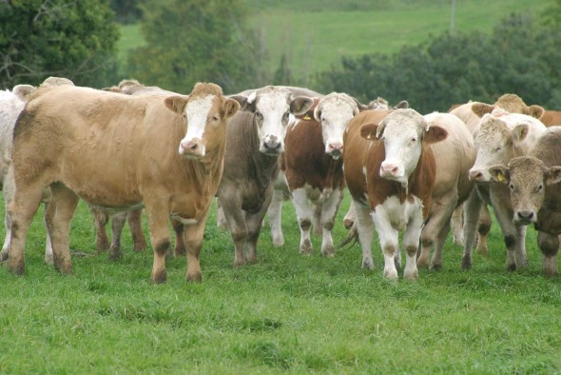
What are these?
Text here
Beef bulls

Slide 3
What do we call the meat we get from beef bulls?
Text here
Beef

Slide 4
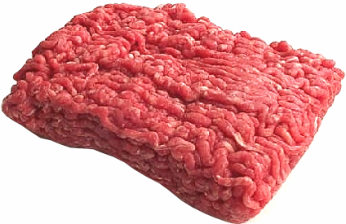
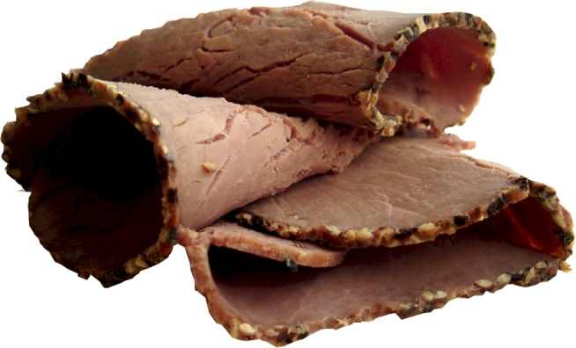
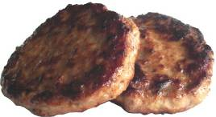
What foods are made from beef?
Minced beef
Roast beef
Beef burgers

Slide 5
What is this?
This is a dairy cow.

Slide 6
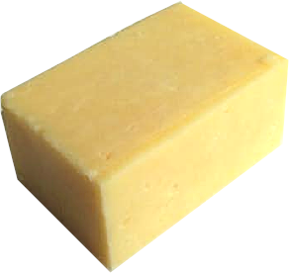
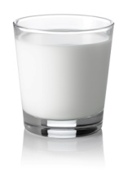
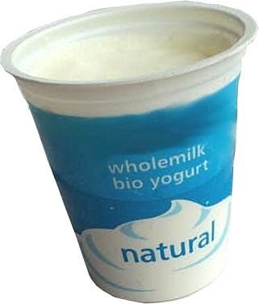
Can you guess what foods come from a dairy cow?
What foods are made from milk?
Cheese
Milk
Yogurt

Slide 7
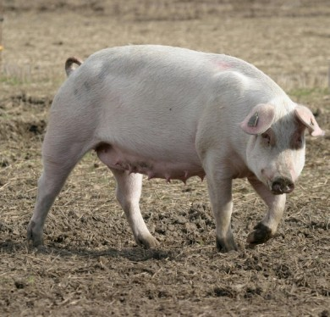
What is this?
A pig

Slide 8
What do we call the meat we get from pigs?
Pork

Slide 9
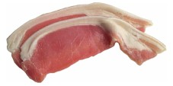
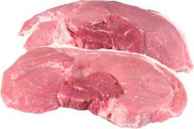
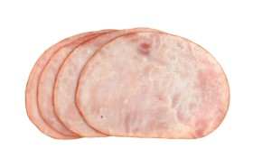
What foods are made from pork?
Bacon
Pork steaks
Ham

Slide 10
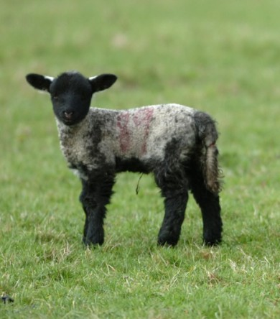
What can you see here?
A lamb

Slide 11
What do we call the meat we get from lambs?
Lamb

Slide 12
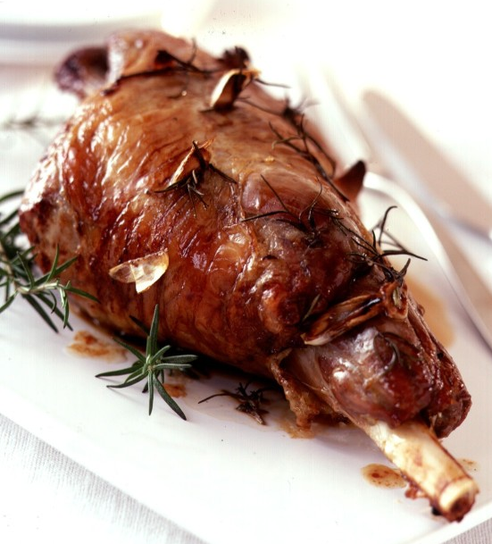
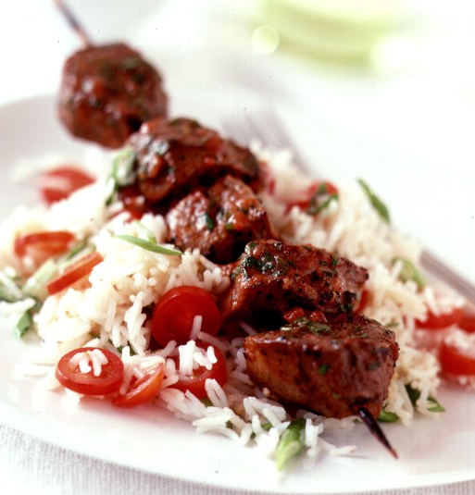
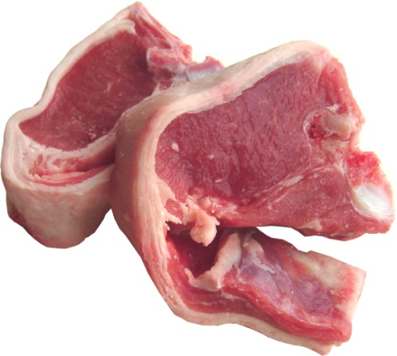
What foods are made from lamb?
Roast lamb
Lamb chops
Lamb kebab

Slide 13
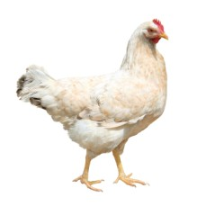
What can you see here?
A chicken

Slide 14
What do we call the meat we get from chickens?
Chicken

Slide 15
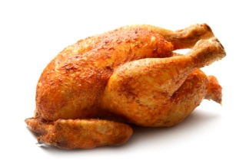
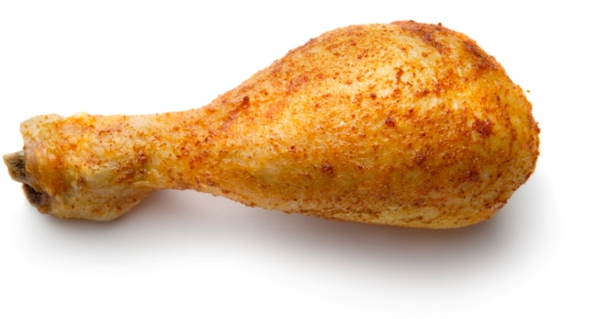
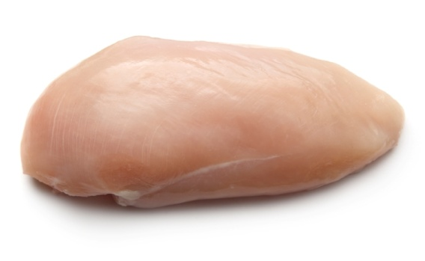
What foods come from chicken?
Chicken drumstick
Roast chicken
Chicken breast

Slide 16
What other food can we get from chickens?
Eggs
Chickens that lay eggs are called hens.

Slide 17
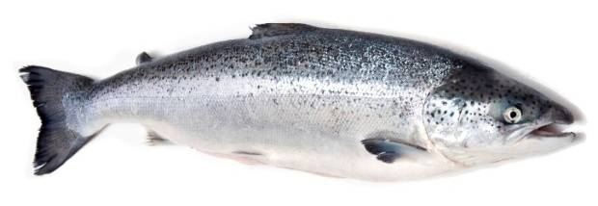
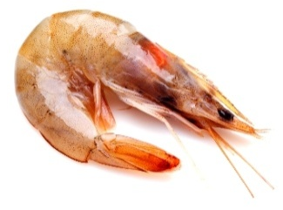
What can you see here?
Fish
There are lots of different types of fish. Here is a cod, a salmon and a prawn.

Slide 18
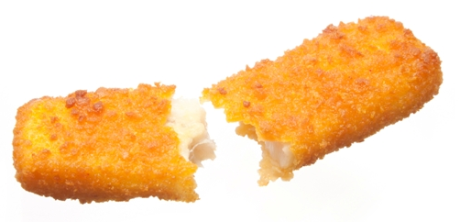
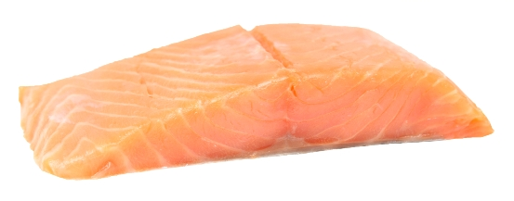
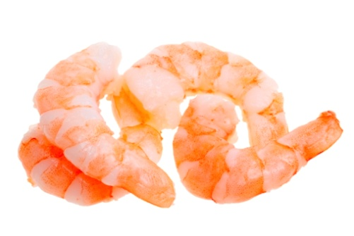
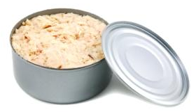
What foods come from fish?
Salmon
Fish fingers
Prawns
Canned tuna

Slide 19
All these foods come from beef bulls.
Beef bulls
Can you think of any more?

Slide 20
All these foods come from dairy cows.
Dairy cows
Can you think of any more?

Slide 21
All these foods come from lambs.
A lamb
Can you think of any more?

Slide 22
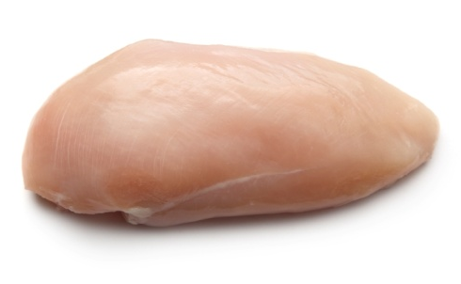
All these foods come from chickens.
Chicken
Chickens which provide meat are called broilers.

Slide 23
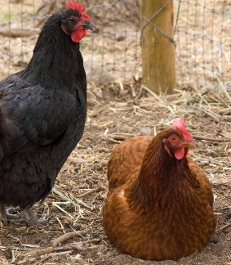
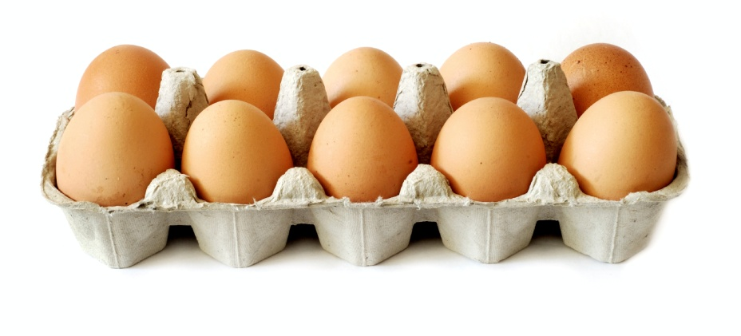
Eggs come from hens.
Hens

Slide 24
All these foods come from different types of fish.
Fish
Can you think of any more?

Slide 25
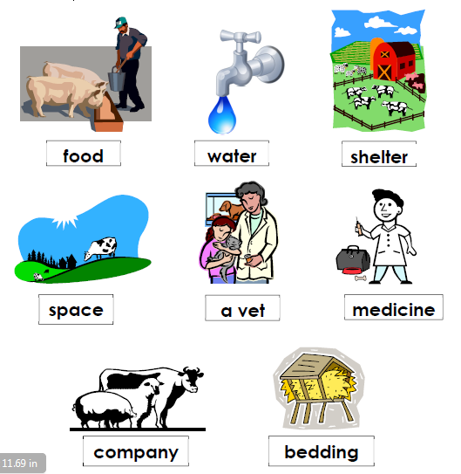
Animals need to be looked after so they healthy. Here are some of the things they need:

Slide 26
For further information, go to:
www.foodafactoflife.org.uk

